Slide 1


Commissioning of a Coordinate Detector for the Hall A Super BigBite Spectrometer at Jefferson Lab
Ralph Marinaro
Christopher Newport University
April 5, 2018

Slide 2
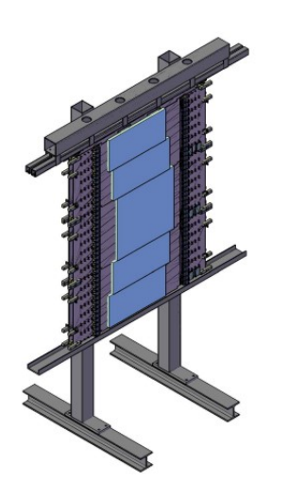
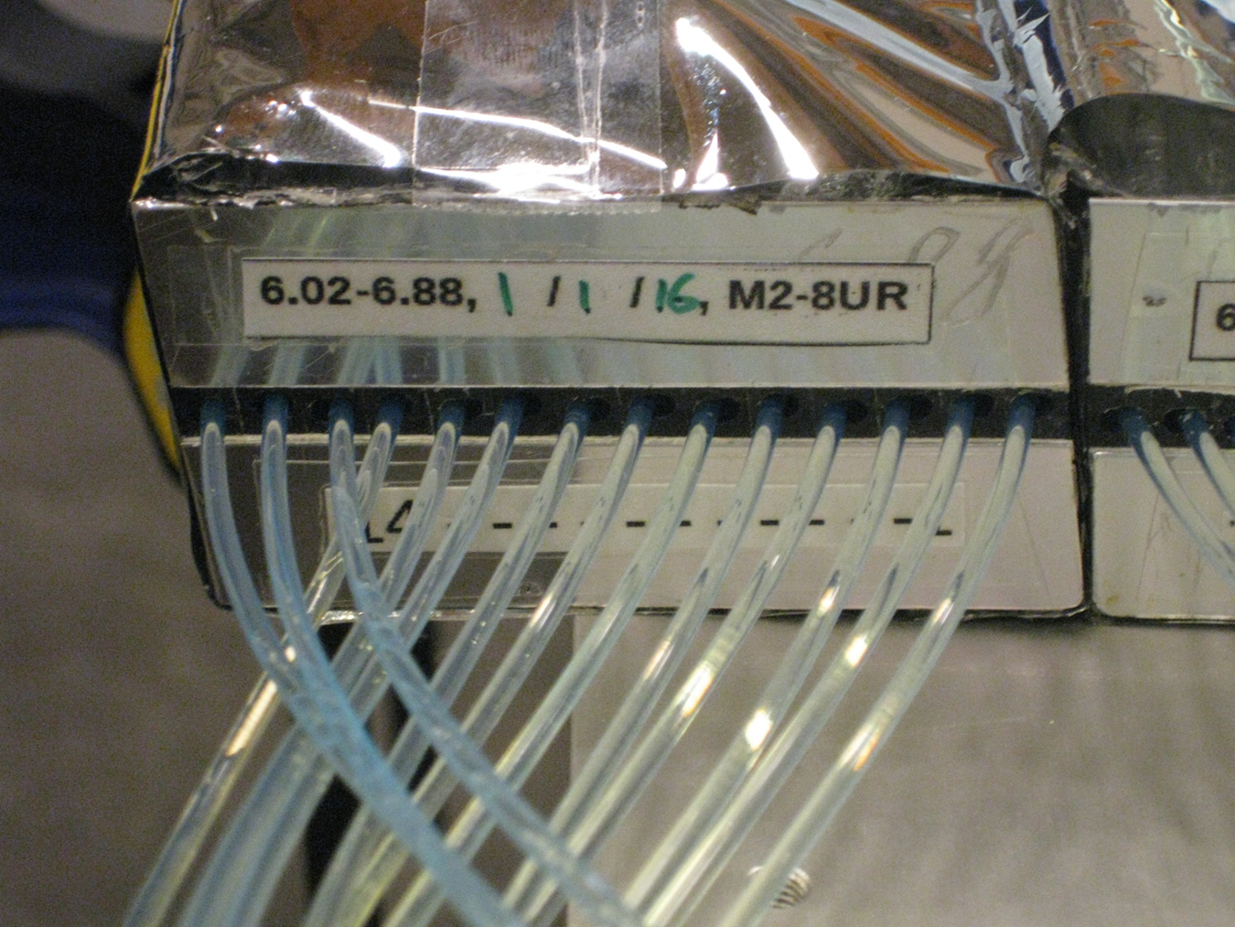
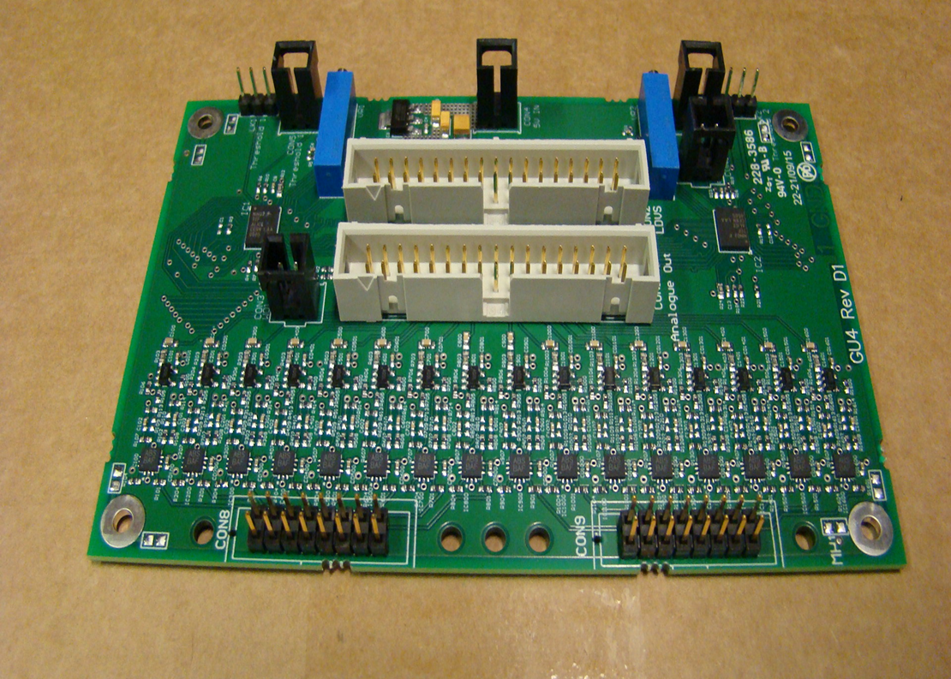
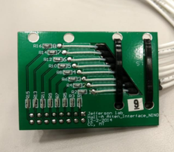
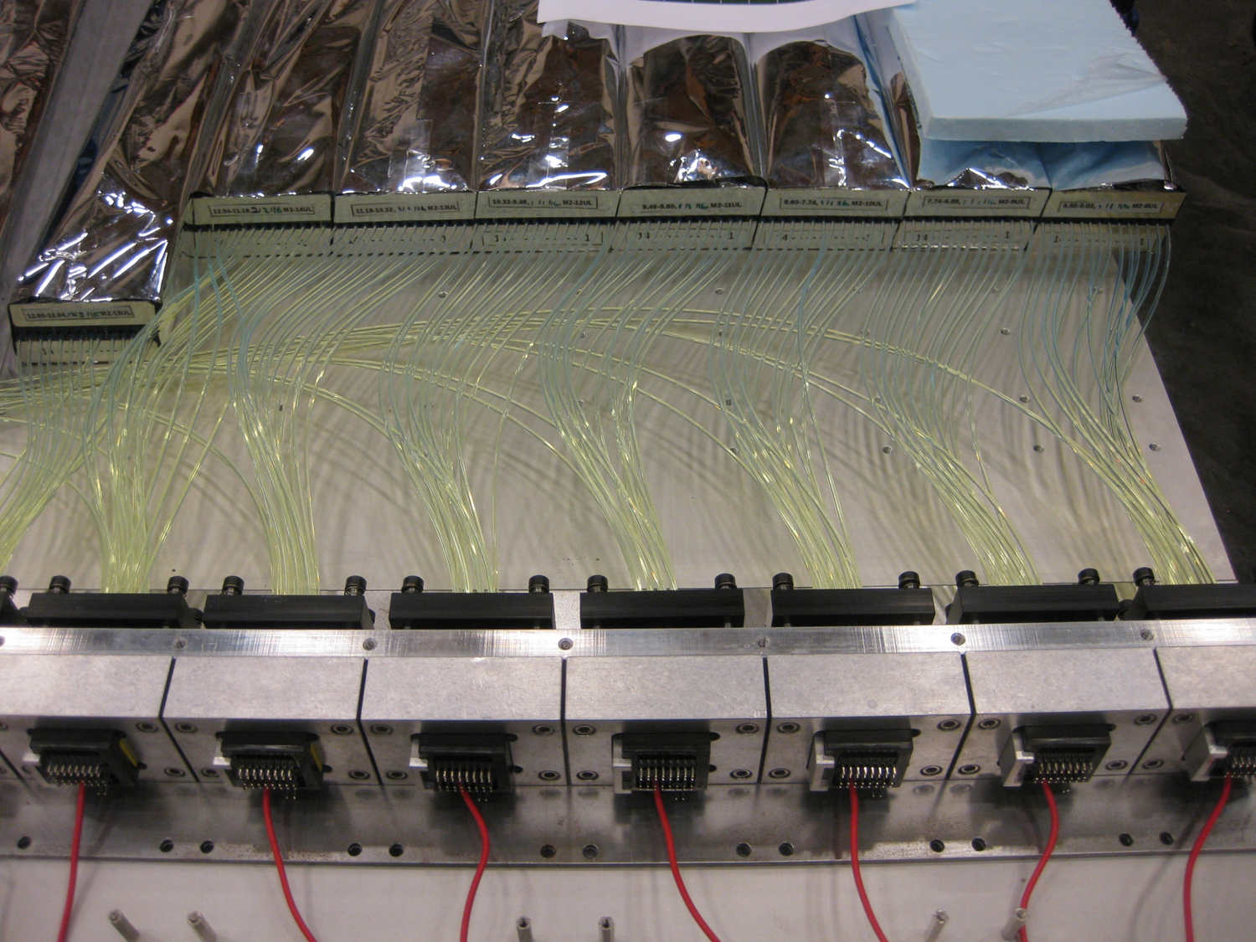
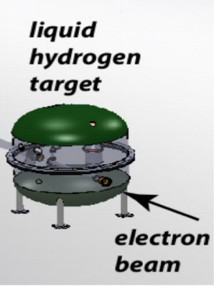
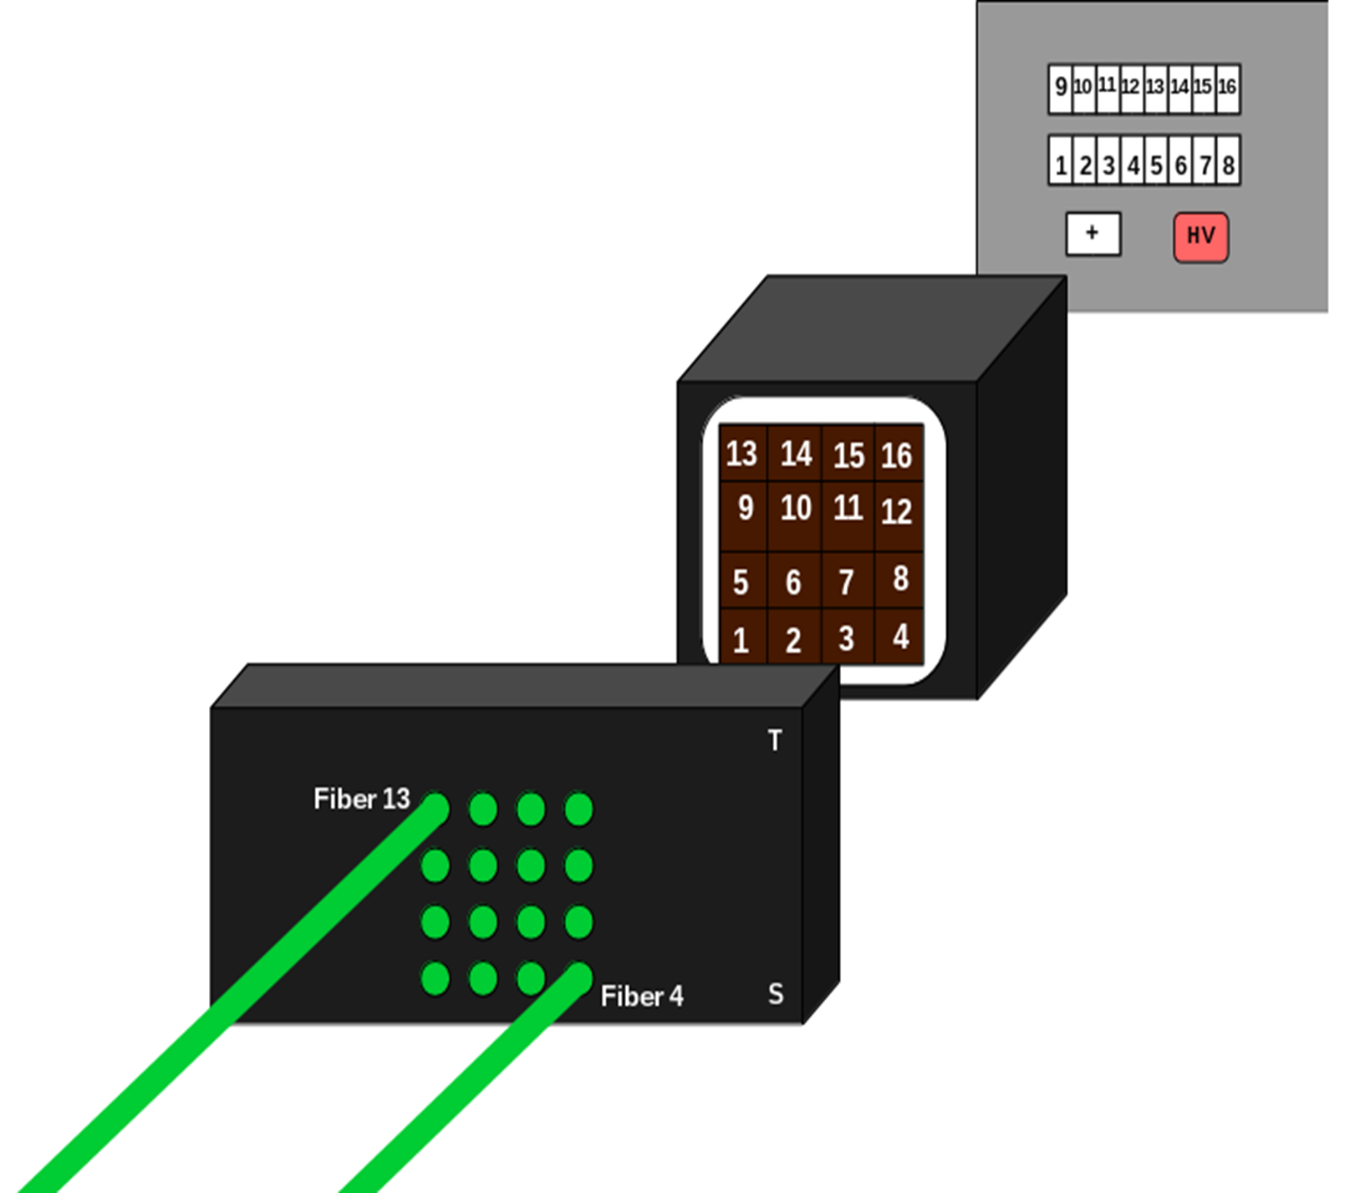
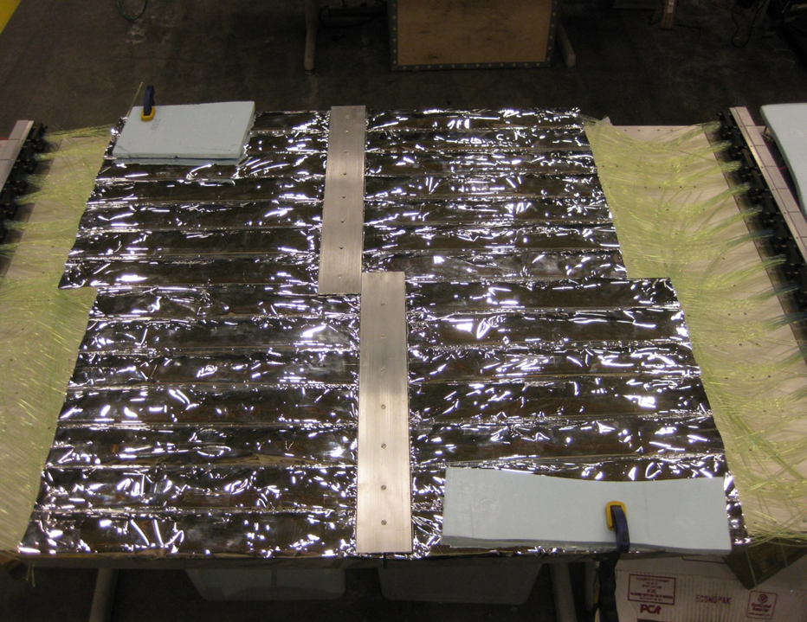
Detector Design
Scintillating Material
NINO’s
Connectors
Optical Fibers
PMT’s
Module

Slide 3
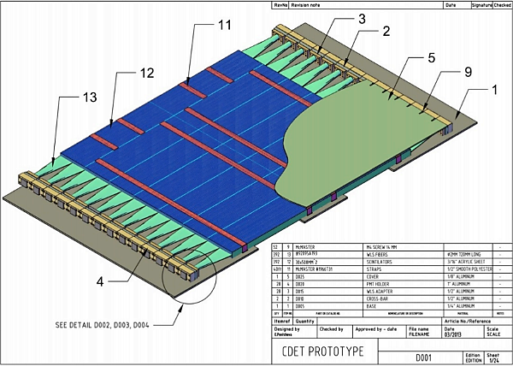
Detector Design – One Module
14 scintillating paddles per bar
Each bar offset with a specific angle
16 optical fibers inserted through paddle centers
2 rejected optical fibers per bar
14 Optical fiber groups attached to 14 collars
Each collar rests against one PMT
28 PMT’s, collars, and bars per module
Each PMT is attached to a NINO with 2 connector boards
Each connector board has 16 resistor values
28 NINO’s and 56 connectors per module
392 channels per module
2,352 channels in the detector

Slide 4
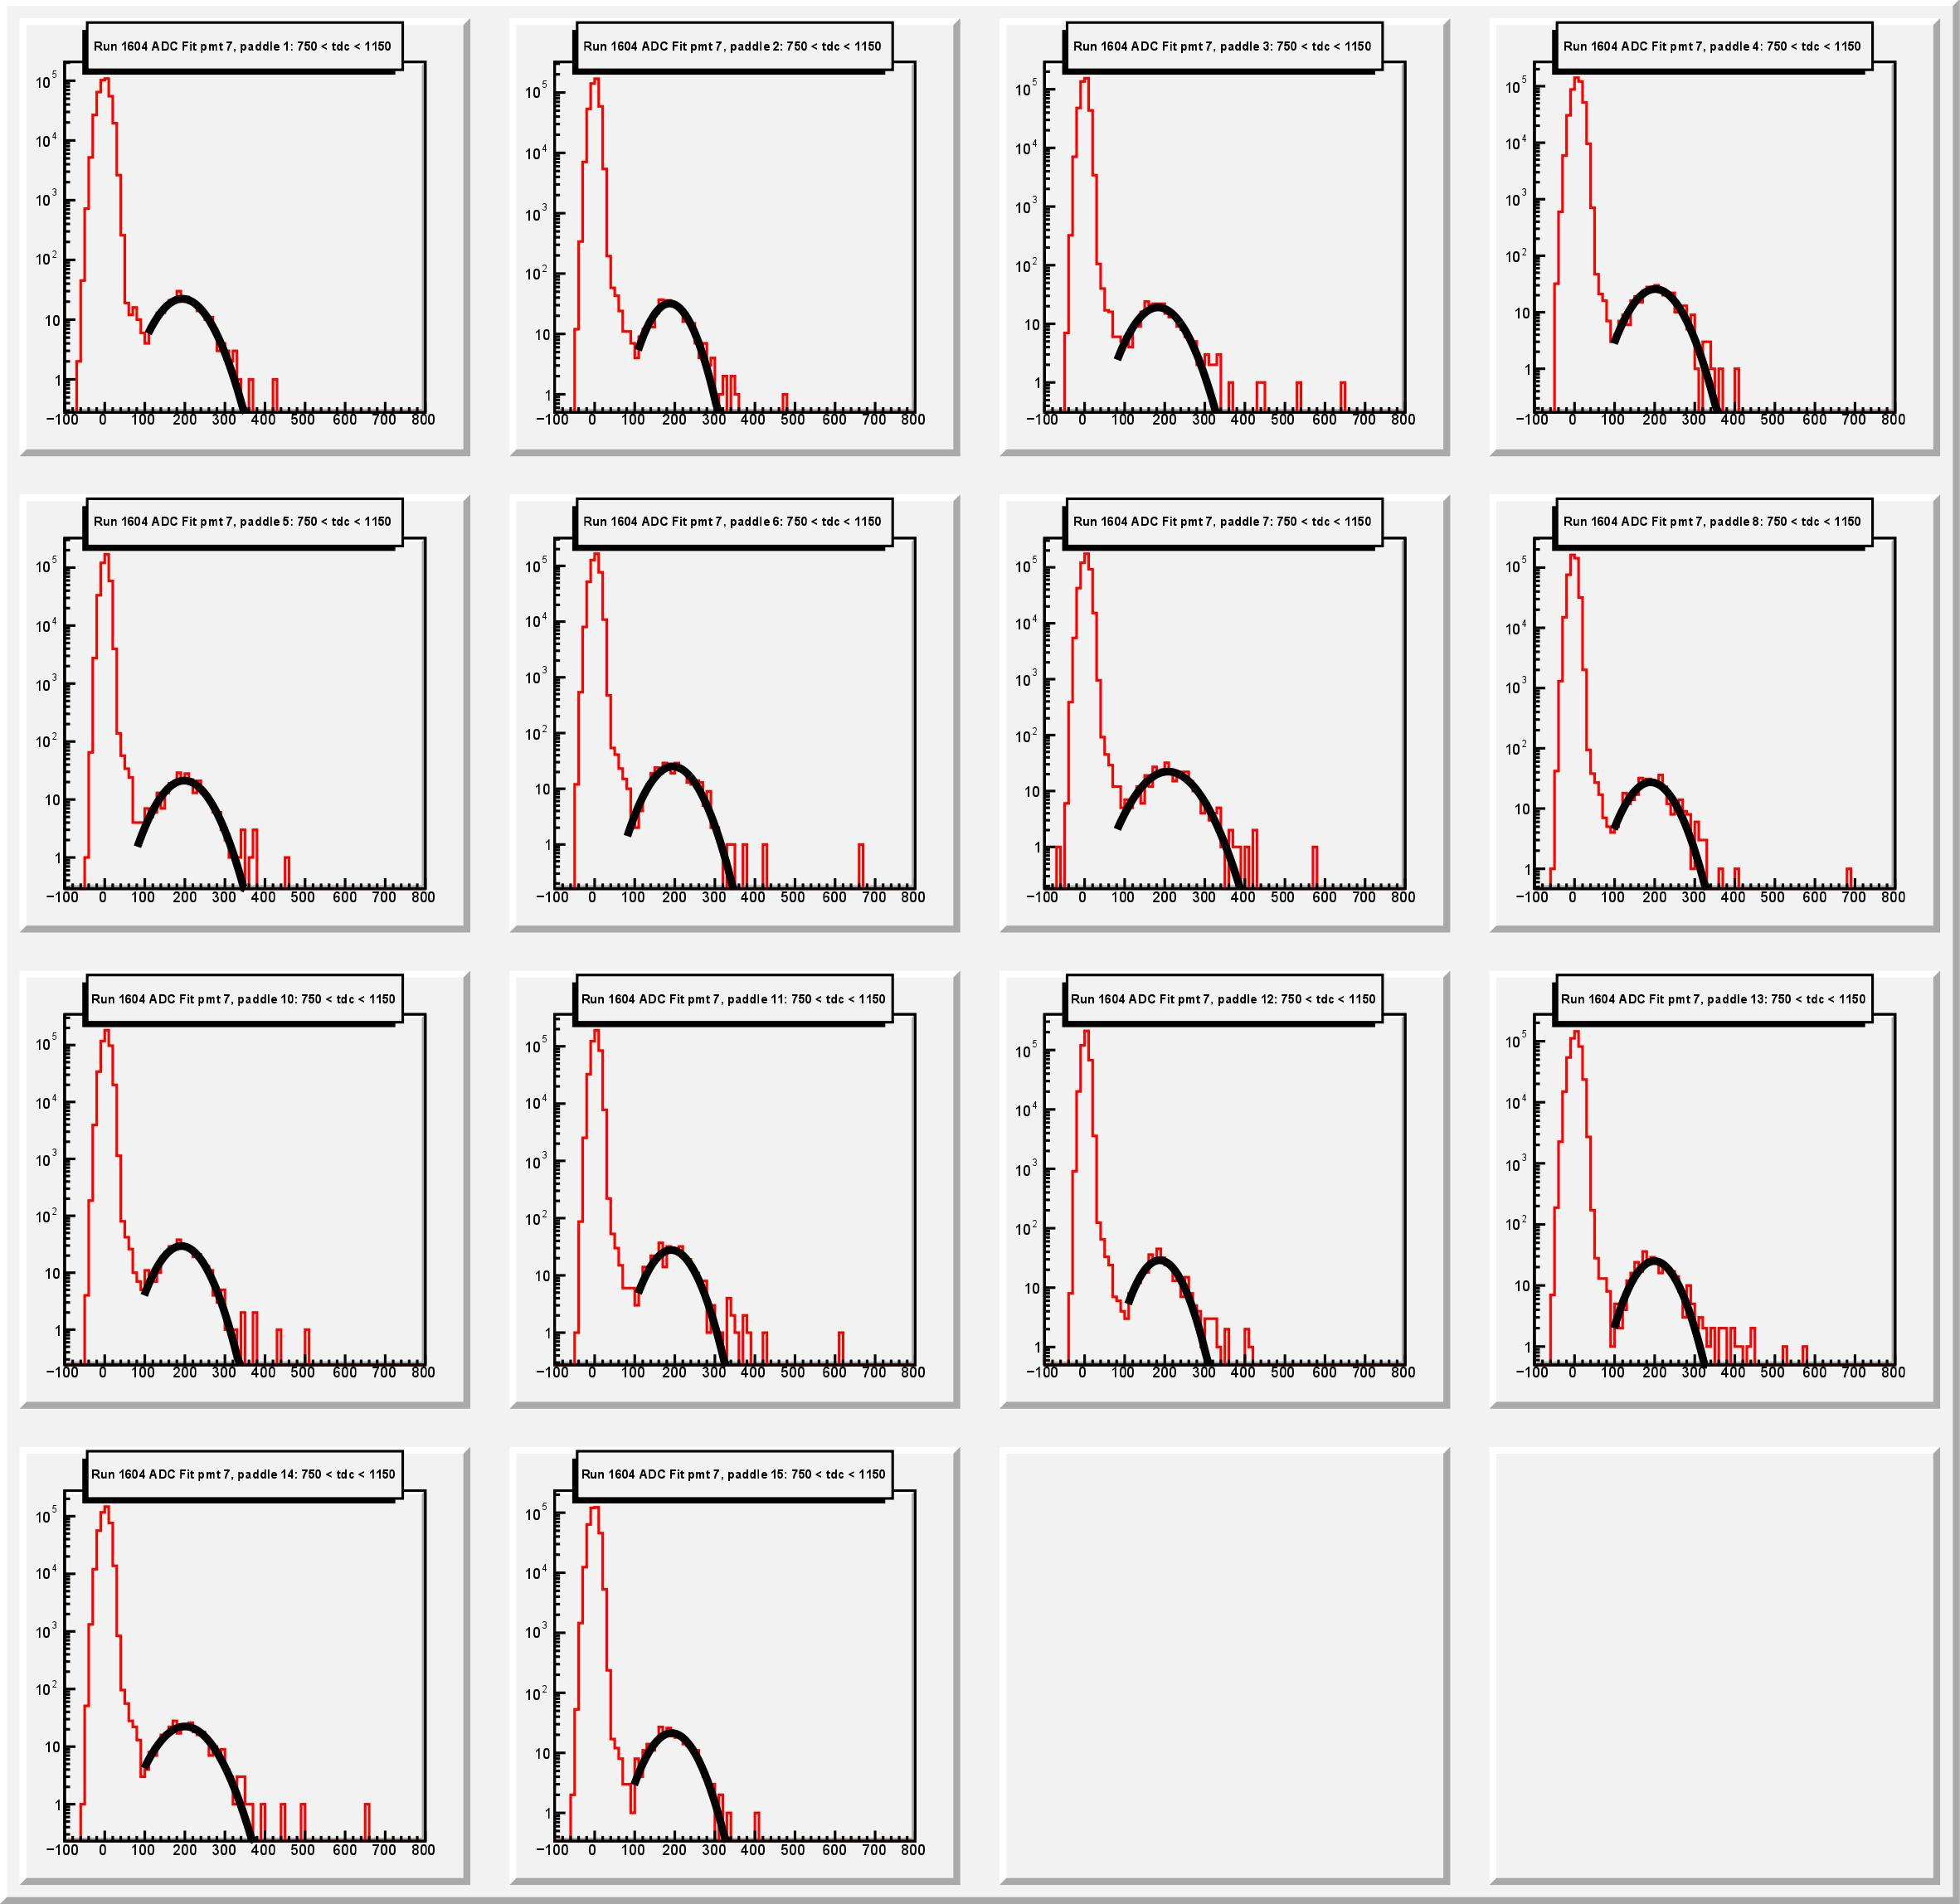
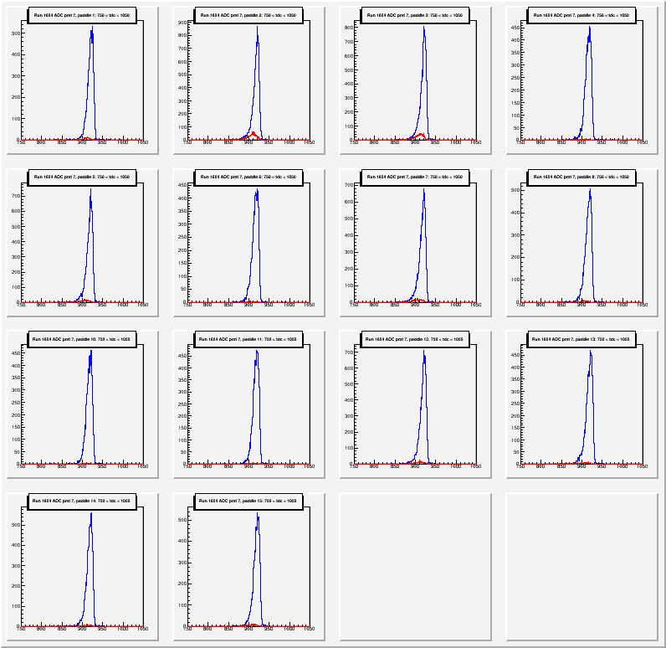
Data – ADC/TDC

Slide 5
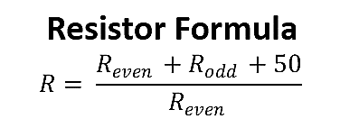
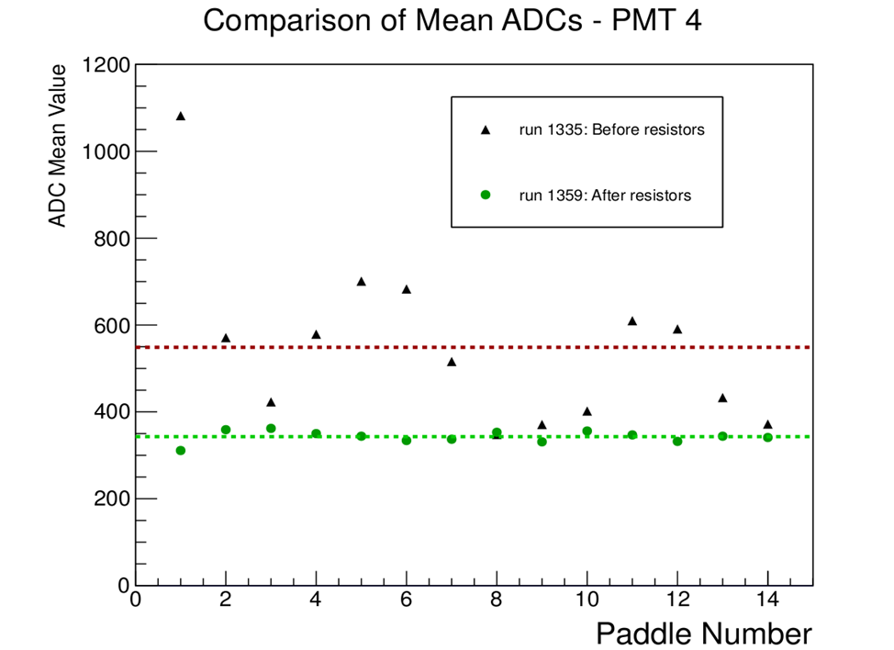
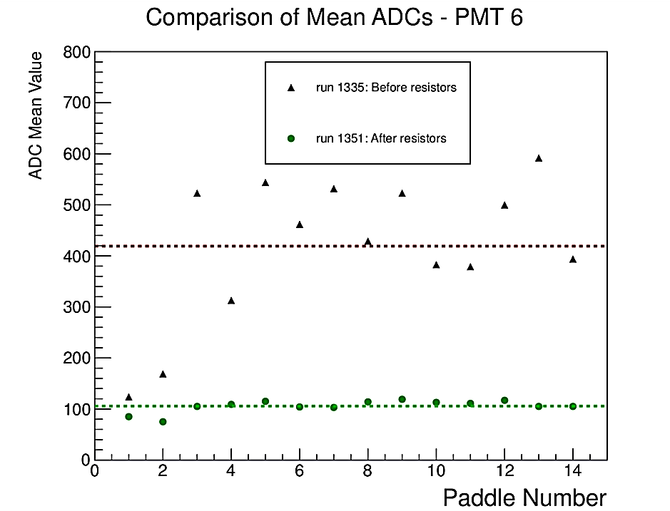
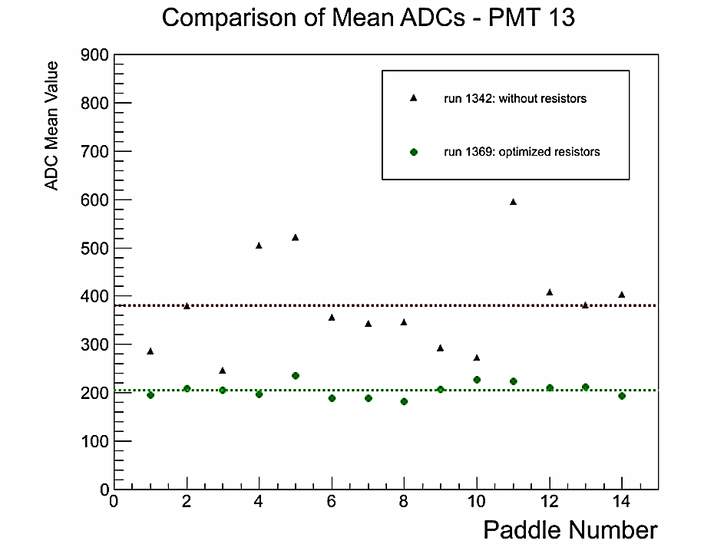
Charge Normalization

Slide 6
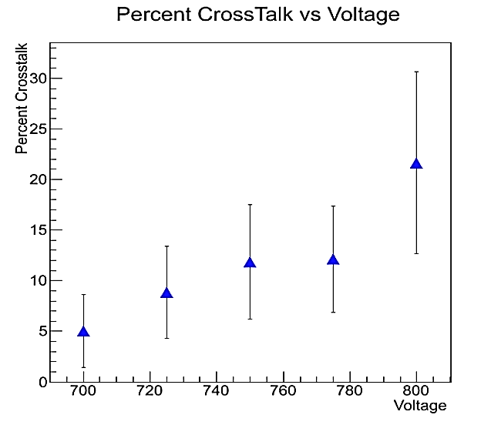
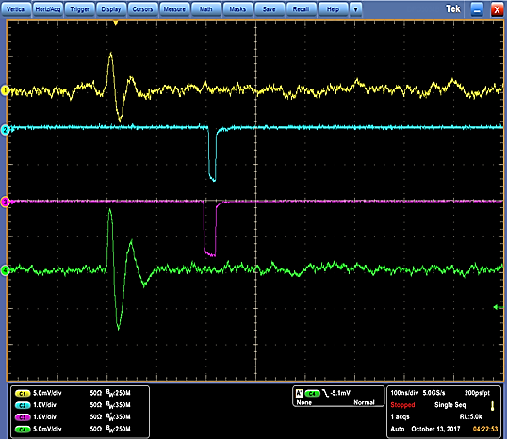
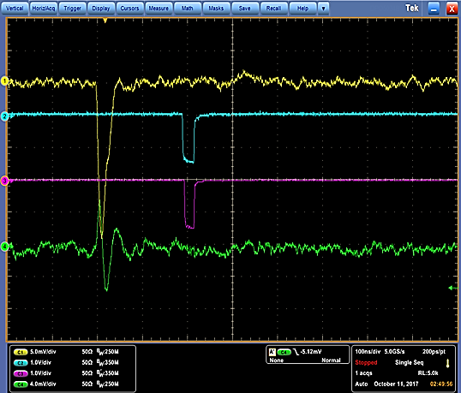
Crosstalk
Definition
the parasitic, artificial correlation of events between channels in the PMT which generates incorrect data events that did not really occur

Slide 7
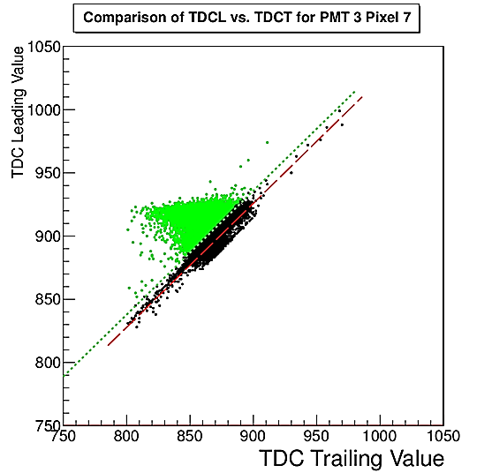
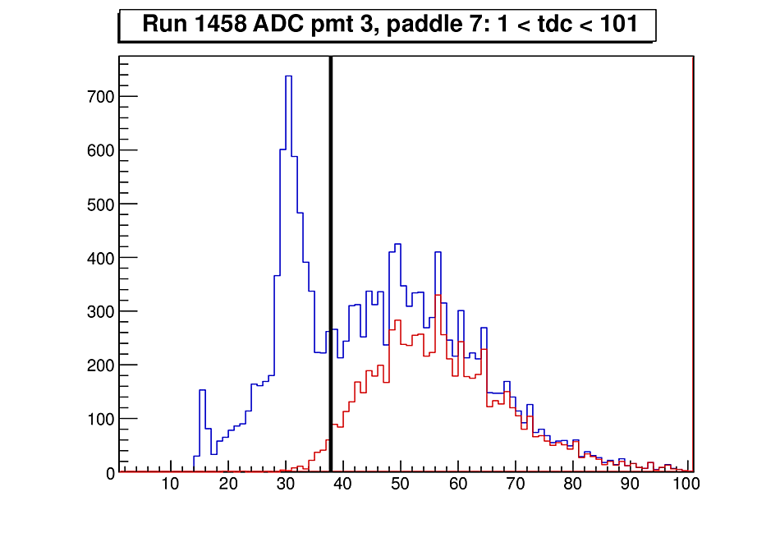
Crosstalk - Reduction
Number of Events
TDC Width

Slide 8
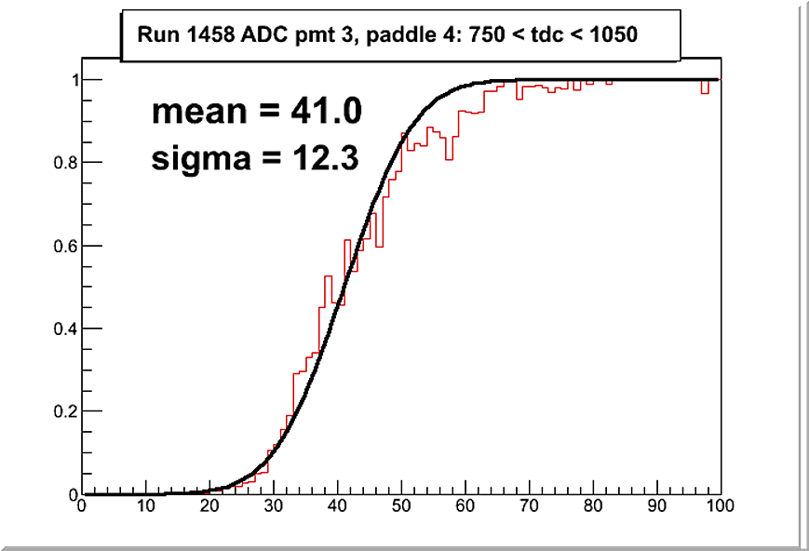

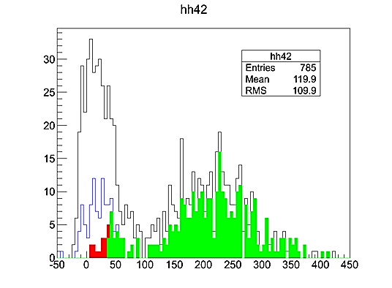
Efficiency
Black – vertical tracks
Blue – crosstalk reduction
Red – TDC width cut
Green – threshold cut
ADC ratio
Number of Events
ADC rate
ADC

Slide 9
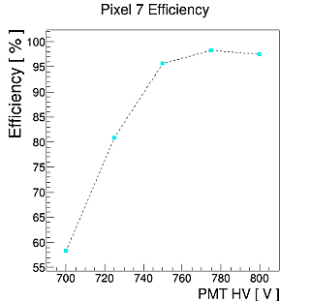
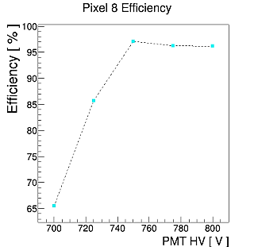
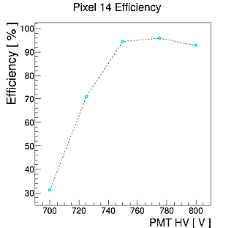
Efficiency
$$Eff= \frac{\sum{events above threshold}}{\sum{events above threshold+events above TDC width cut}}$$

Slide 10
QUESTIONS?

